Slide 1
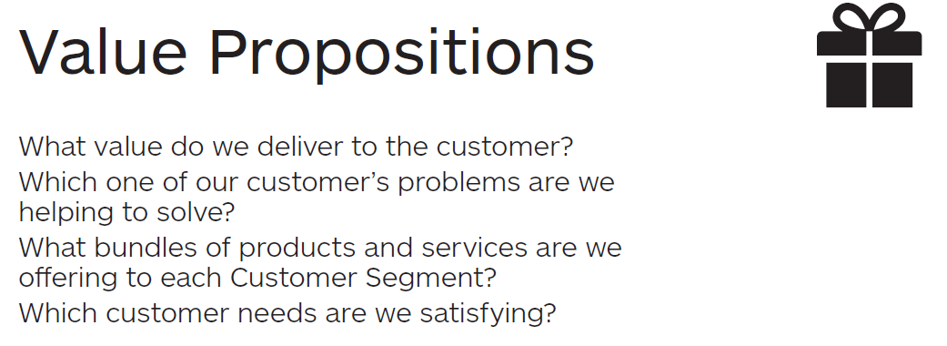

Value
Propositions
1

Slide 2
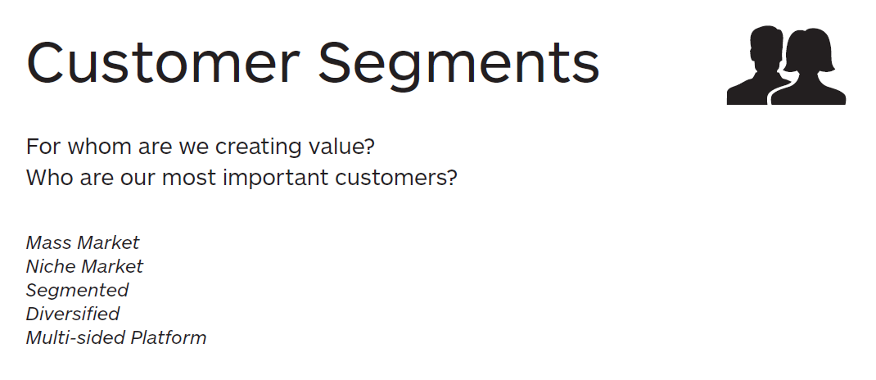
Customer
Segments
2

Slide 3
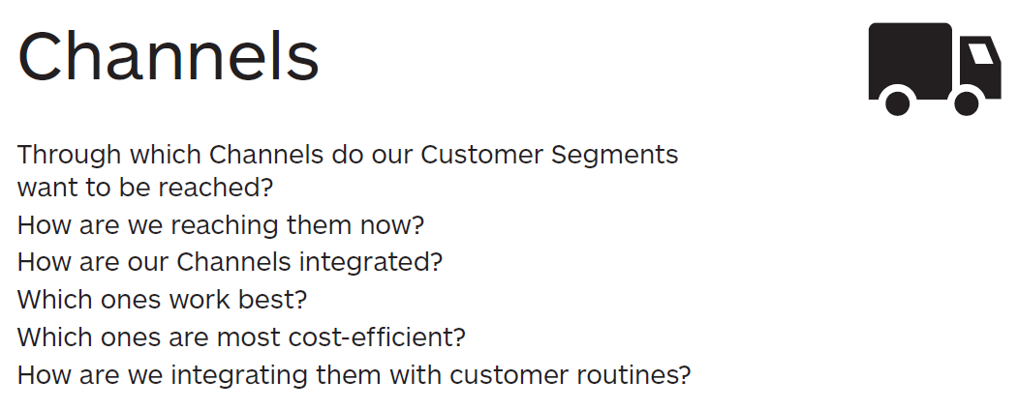
Channels
3

Slide 4
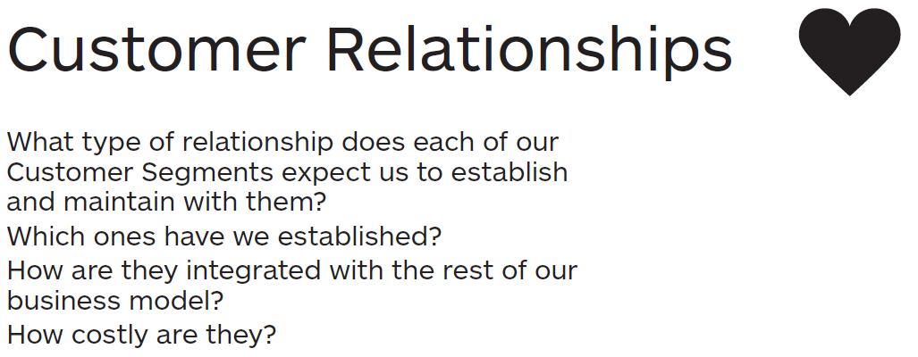
Customer
Relationships
4

Slide 5
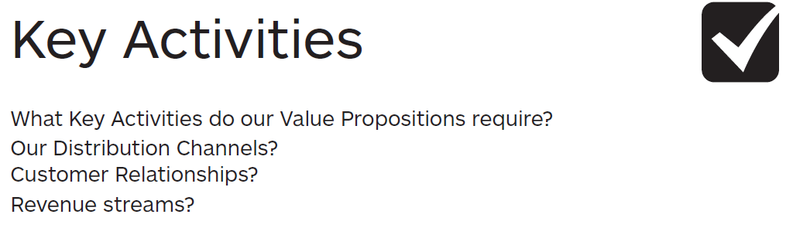
Key
Activities
5

Slide 6
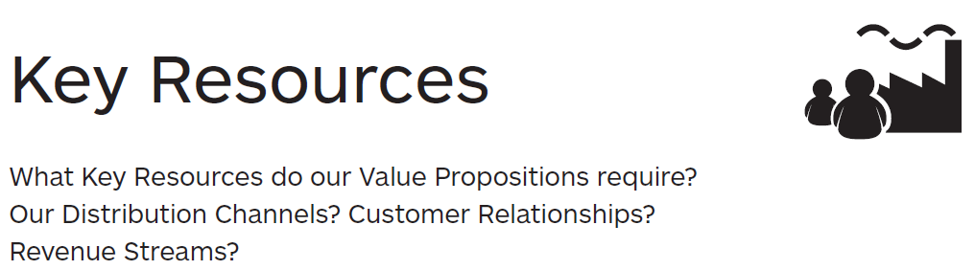
Key
Resources
6

Slide 7
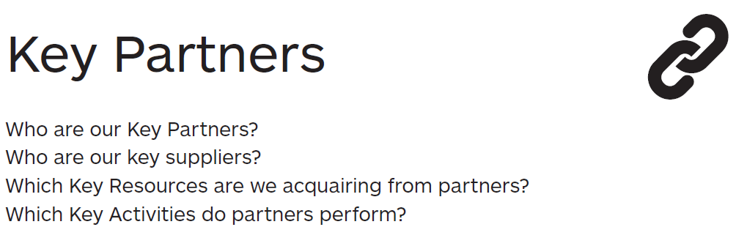
Key
Partners
7

Slide 8

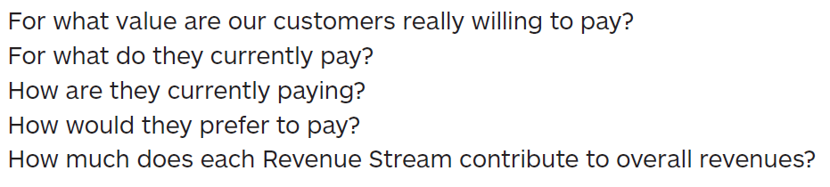
Revenue
8
Streams

Slide 9

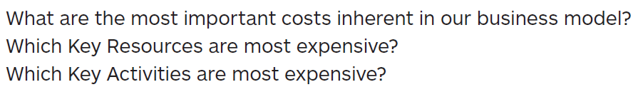
Cost Structure
9

